Slide 1



Olist Ecommerce Project Analysis

Slide 2
Dashboards

Slide 3
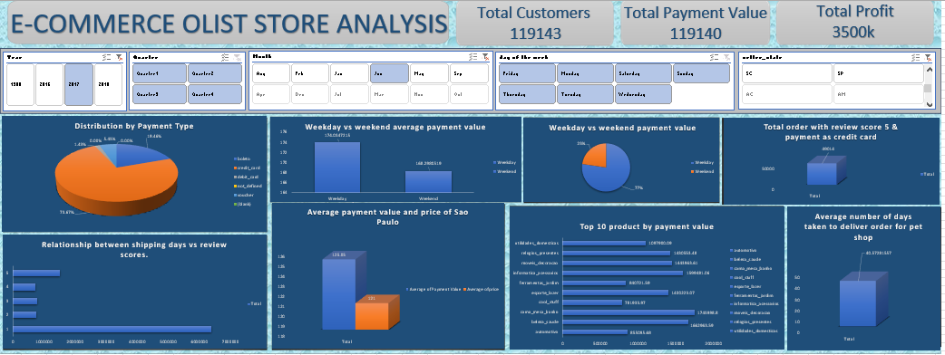
Project Overview – Excel Dashboard

Slide 4
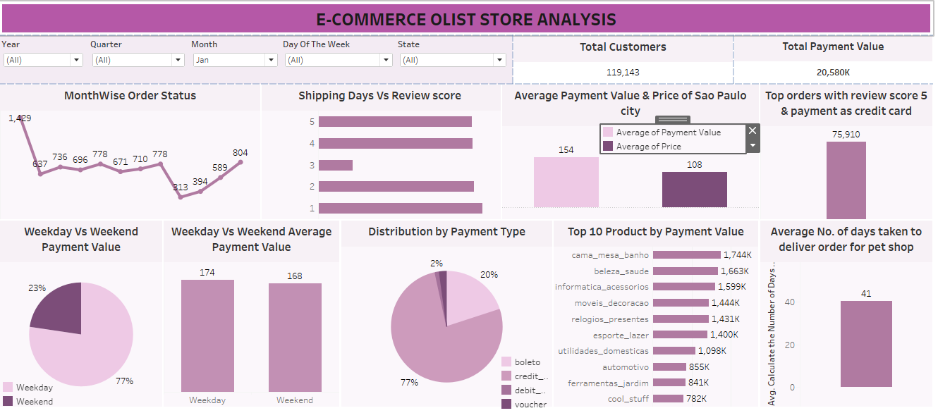
Project Overview – Tableau Dashboard

Slide 5
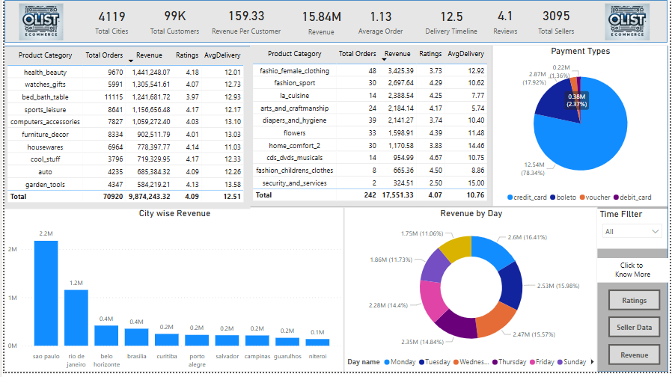
Project Overview – PowerBI Dashboard

Slide 6
Project Insights
Low Repeat Orders (Avg. 1.13): Improve customer retention with loyalty programs, personalized follow-ups, and better product ratings & delivery.
Sao Paulo (13% Share): High seller concentration drives sales—expand sellers to other cities for balance.
Rio’s Growth Potential: Boost revenue by increasing sellers.
Delivery & Ratings: No timeline improvement since 2017-18—optimize logistics and enhance fulfillment.

Slide 7
Challenges faced and potential solutions
Since there are many tables, we need to ensure that all of them are connected to obtain accurate results.
There are numerous insights that can be generated. We need to determine which data is relevant for driving business growth.
We have used DAX formulas such as RELATED, RELATEDTABLE, FILTERS, AVERAGE, and COUNTROWS, which has given us confidence in using these DAX functions.

